Slide 1

SARDAR VALLABHBHAI PATEL COLLEGE KAIMUR (BHABHUA) (A CONSTITUENT UNIT OF VEER KUNWAR SIGH UNIVERSITY , ARA BIHAR)
DEPARTMENT OF BIOTECHNOLOGY
WELCOME TO NAAC PEER TEAM

Slide 2
Introduction
The department of Biotechnology has been established in S.V.P. College Bhabua (Kaimur) from 2004-2005 Session, which is a constituent unit of Veer Kunwar Singh University, Ara,Bihar.
The Department of Biotechnology is comes under DBT-Star college scheme Govt. of India and currently offering B.Sc. Biotechnology program as a self financed course.

Slide 3
SVP
MOTTO
“Biotechnology for Rural Development and Sustainable Future.”
OBJECTIVES
To provide a comprehensive understanding of biotechnology principles and practices.
To develop student’s laboratory and analytical skills through hands on training and projects.
To prepare students for careers in academia, industry and public services or for higher studies.
MISSION
To impart high quality education with a focus on scientific enquiry and research.
To equip students with practical skills and ethical values for academic, industrial and entrepreneurial pursuits.
To promote community oriented biotechnological solution for rural advancement.
VISION
To empower rural youth through quality education fostering innovation and research that contribute to sustainable agriculture, health and environmental stewardship.

Slide 4
Committee Members
Dr. S. P. Sharma(Director/Principal)
Dr. Niyaz Ahmad Siddiquee (Bursar)
Mr. Ashutosh Kumar Singh (Member)
Dr. Ajit Rai ( Member)
Mr. Awadesh (Member)
Dr. Anand Prakash (Coordinator)
Dr . Sumit Kumar Rai (Member)
Prof. Maya Sinha (Member)

Slide 5
Headship Chronology
2004-2007
Prof. C. S. Chaudhary
Coordinator
2007-2008
Prof. Maya Sinha
Coordinator
2008-2014
Dr. Vashudev Narayan Alok
Coordinator
2014-2018
Prof. Maya Sinha
Coordinator
2018-2022
Dr. Jitendra Kumar
Coordinator
2022- Till now
Dr. Anand Prakash
Coordinator

Slide 6
Faculty Members
S.No. | Name | Qualification | Designation
1. | Dr. Anand Prakash | Ph.D | Coordinator
2. | Er. Nutan Kumari | M.Tech | HOD
3. | Prof. Maya Sinha |  | Faculty
4. | Dr. Jitendra Kumar | Ph.D | Faculty
5. | Dr. Somesh Shashi | Ph.D | Faculty
6. | Dr. Karuna Kumari Sharma | Ph.D | Faculty
7. | Dr. Upendra Kumar Nirala | Ph.D | Faculty
8. | Mr. Ashutosh Kumar Singh |  | Faculty
9. | Mr. Sonal Patel |  | Faculty

Slide 7
Visiting Faculty/ Experts
S.No. | Name | Qualification
1. | Dr. Yashvant Patel | Research scientist, CGD,BHU Varanasi(U.P.)
2. | Dolly Krishnan | Director of Brainology, Ranchi (Jharkhand)
3. | Dr. Thakur Shyam Ji Prasad Sinha | Rtd. Prof. RSD College (Bhagwanpur)

Slide 8
Non-teaching Staff
Mrs. Anita (Computer Operator)
Mr. Anil Kumar (Support Staff)
Mr. Ramadin Singh (Support Staff)

Slide 9
Curricular Aspects
First Year
Biochemistry
Second Year
Biophysics
Third Year
Animal Cell Biology
Mathematics and Practical computers
Cell Biology
Genetics
Microbiology
Biochemical Techniques
Microbiological Techniques
Job Training
Molecular Biology
Immunology
Animal Cell Culture
Recombinant DNA Technology
Methods in molecular and cellular Biology
Immunological Methods
Plant Biotechnology
Environmental
Biochemistry
Culture Method
Project Report
Summer Job Training
Subsidiary Paper (Either Botony or Zoology, Chemistry)
Subsidiary Paper (Either Botony or Zoology, Chemistry

Slide 10
Programme outcomes
PO1 – Core Knowledge: Demonstrate foundational and advanced knowledge in biotechnology and allied disciplines such as biochemistry, genetics, microbiology, and molecular biology.
PO3 – Research Orientation: Develop the ability to design, conduct, and interpret scientific experiments, especially in areas of genetic engineering, cell culture, and molecular diagnostics.
PO5 – Communication and Teamwork: Effectively communicate scientific ideas and work collaboratively in interdisciplinary teams to achieve research and developmental goals..
PO6 – Lifelong Learning: Pursue higher education, professional development, or entrepreneurship in biotechnology, with an aptitude for continuous learning and innovation.
PO2 – Scientific Aptitude: Apply scientific methods and laboratory skills to analyze biological systems and solve real-world problems.
PO4 – Ethical and Social Responsibility: Understand and uphold ethical principles in biotechnology research and applications, with awareness of societal, environmental, and bioethical implications.
PO7 – Computational and Analytical Skills: Utilize computer applications, bioinformatics tools, and statistical methods for data analysis and modeling in biological systems.
PO8 – Environmental and Sustainable Development: Understand the role of biotechnology in addressing environmental challenges and promoting sustainable development.

Slide 11
Courses with Employability/Skill Development/ Value Added Courses
Molecular Biology and Genetics, RDT - R&D, Technicians
Plant biotechnology- Agriculture and Horticulture
Biophysics – biomedical equipment technician
Immunology- Diagnostic Labs
Environmental Biochemistry –environment agencies and green startup
Biotechnology – Pharmaceutical and biotech industry

Slide 12
Programmes for Slow Learners
Peer assisted teaching
Informal interaction and mentorship
Regular monitoring
Remedial Classes

Slide 13
Teaching Learning and Evaluation
Classical
Chalk & Duster
ICT Enabled tools
Smart class
Google meet
Expert Online Classes

Slide 14
Gender Diversity

Slide 15
Student Diversity

Slide 16
Student Performance Analysis

Slide 17
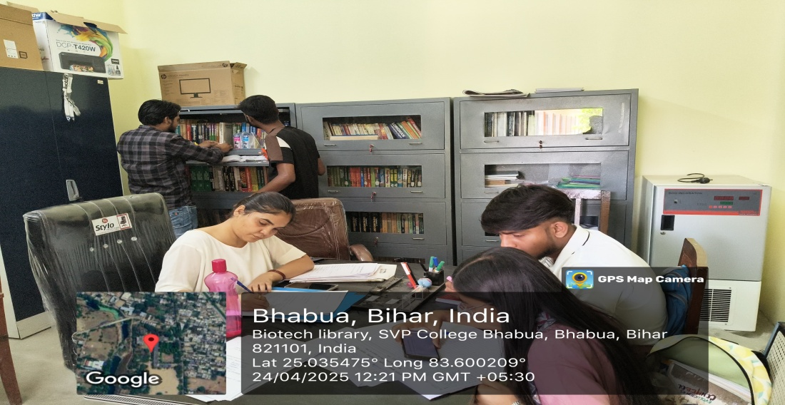
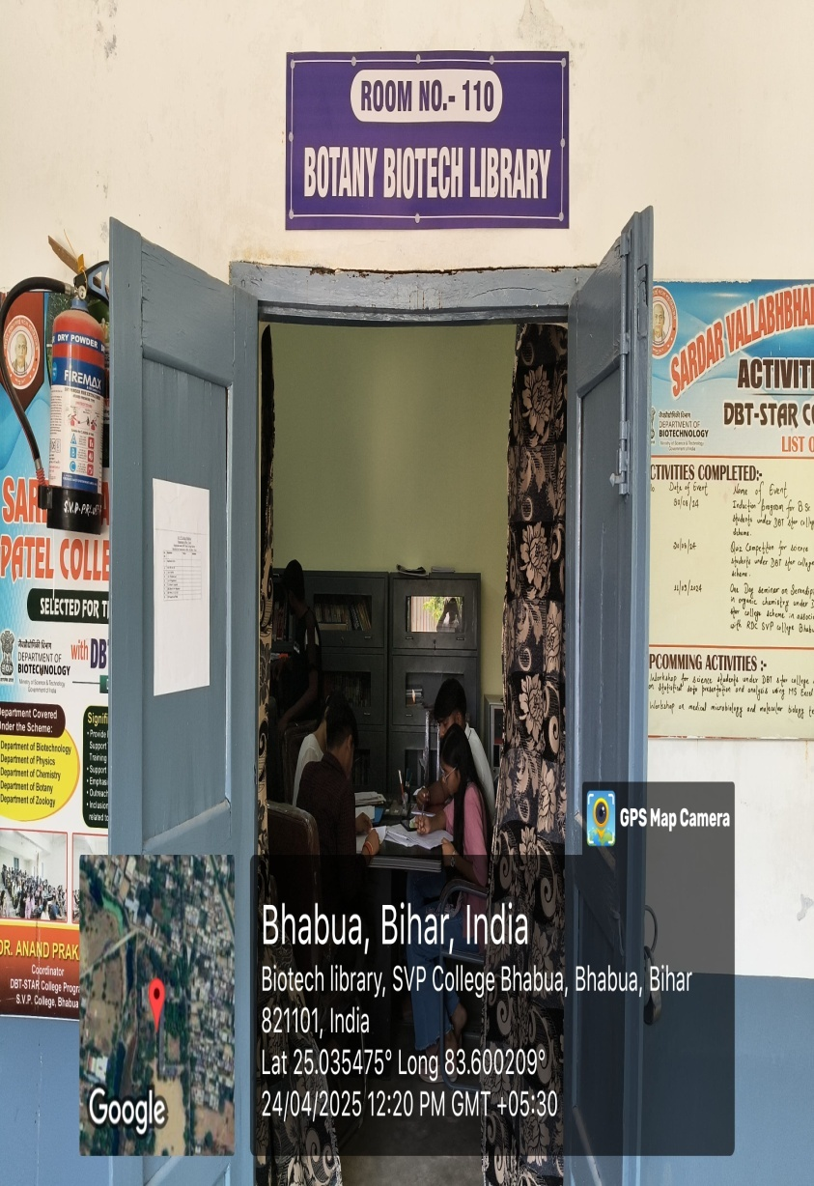
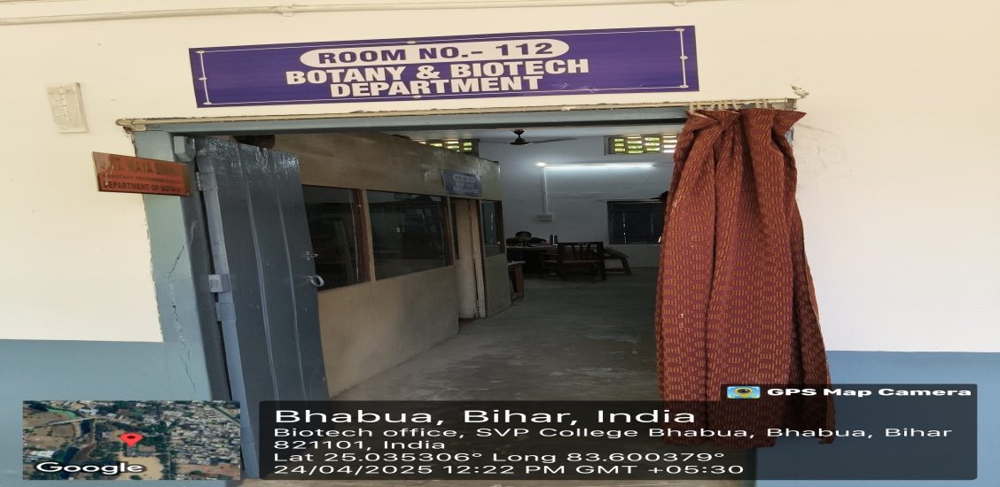
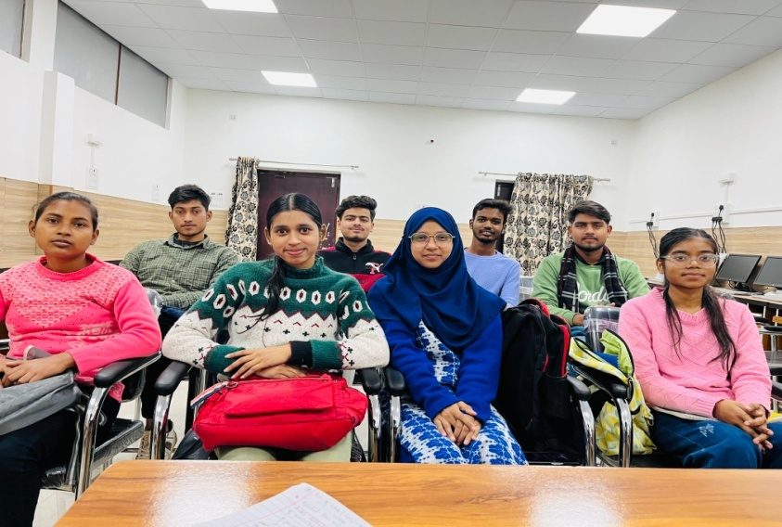
Infrastructures
Biotech Library
Biotech Office
Class Room

Slide 18
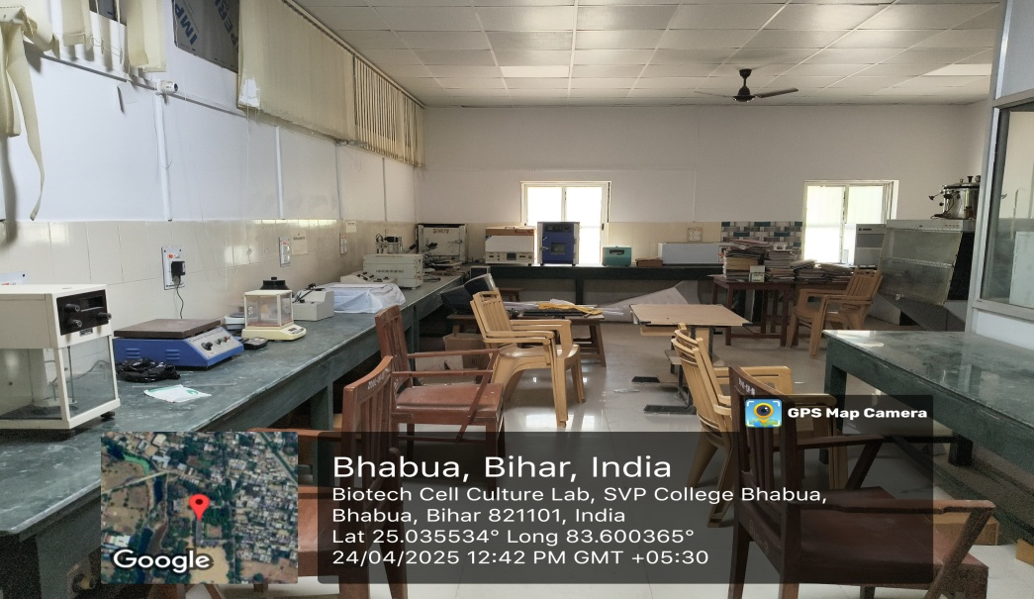
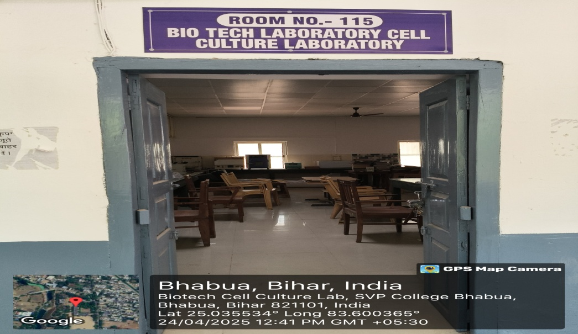
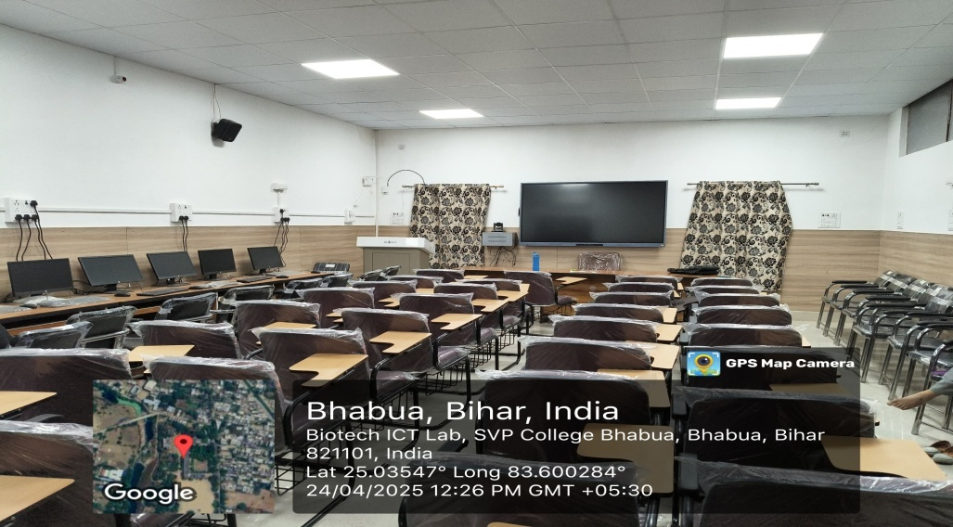
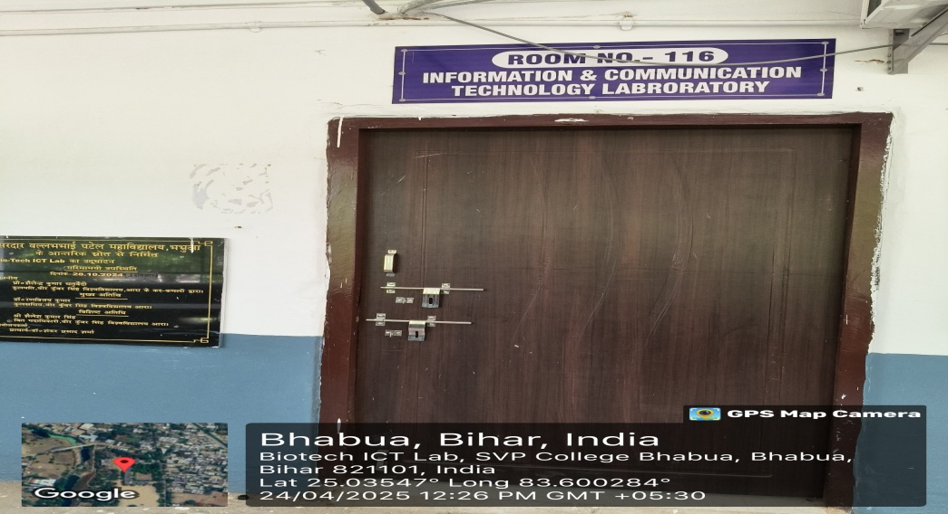
Infrastructures
Biotech laboratory
ICT Lab

Slide 19
Student Support and Progression
Scholarship for female students
Online learning programs, workshops, seminars
Placement Cell
PRACC : Encourage students for civil services/Govt. Jobs/Higher studies
National Apprenticeship Promotion Scheme (NAPS)

Slide 20
Mentor-Mentee system
Mentor- Mentee system
It promotes peer learning, identifies the student competencies and encourage participation in challenging programme
Also provide individual attention
Mentor/Mentee Ratio
Biotechnology: 16:1(1mentor for every 16 students)

Slide 21
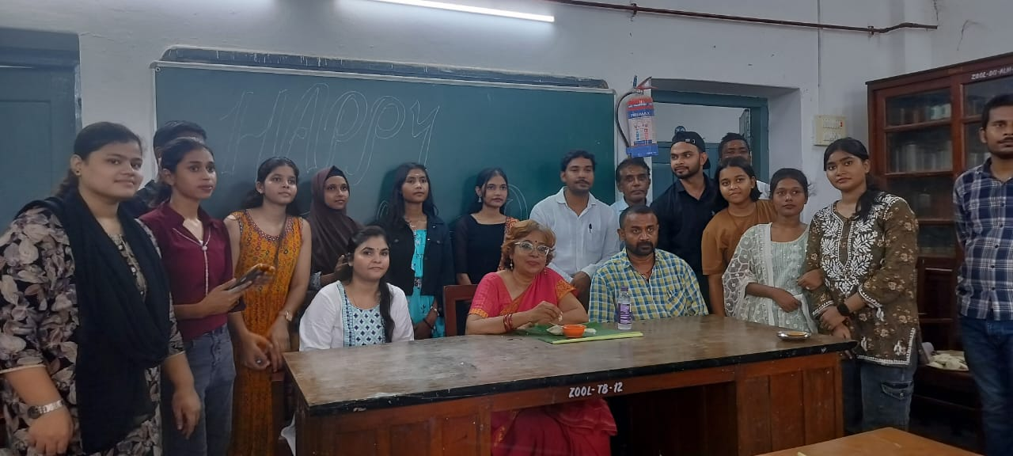
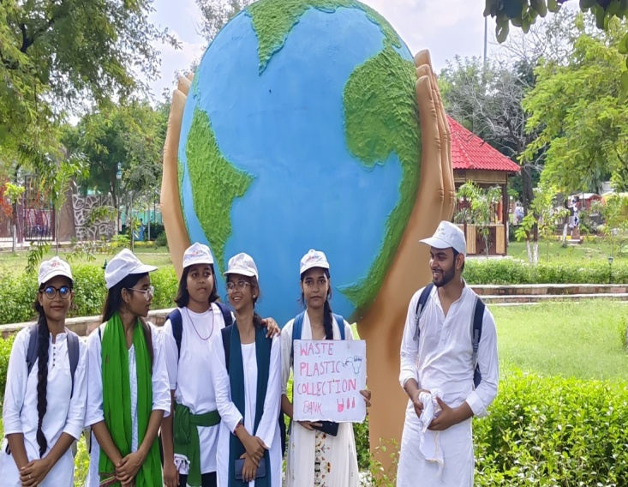
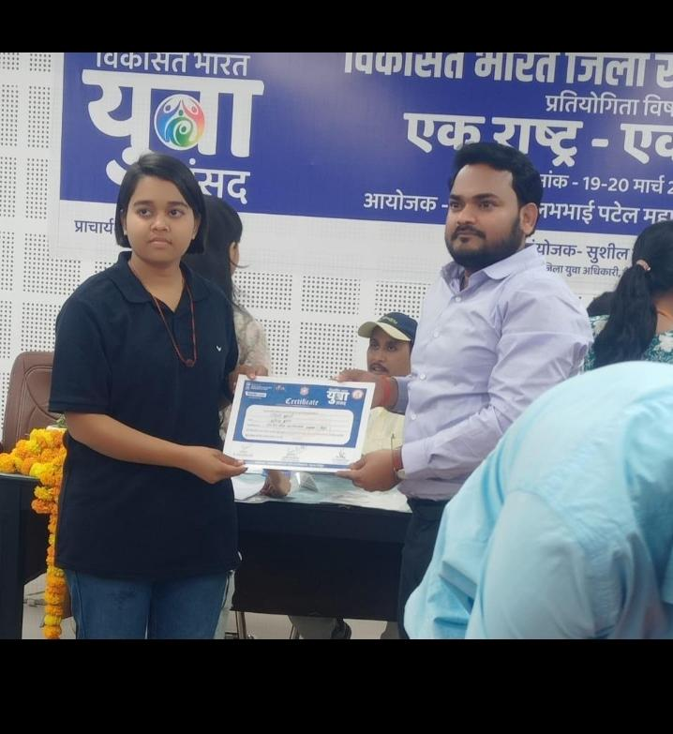
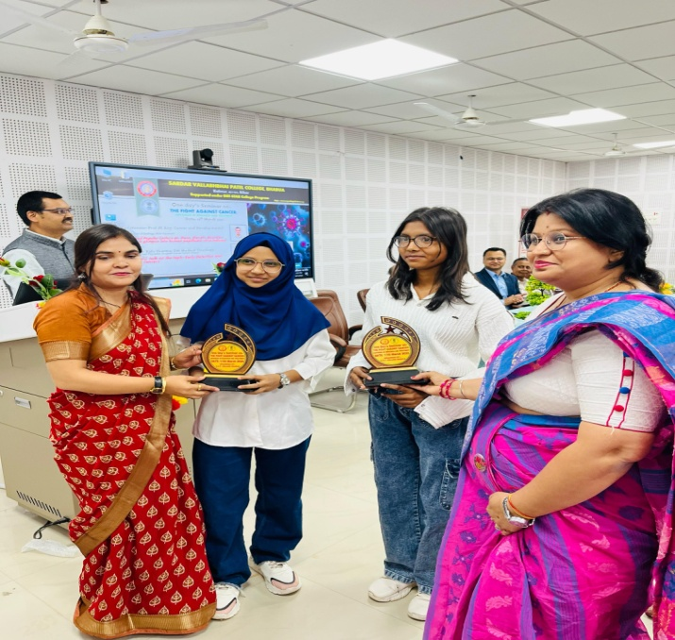
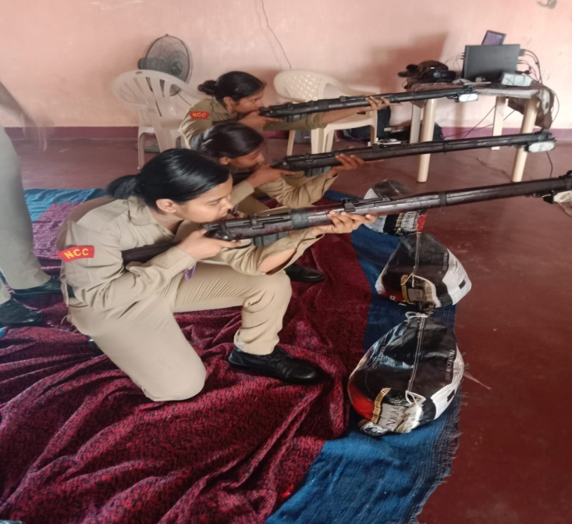
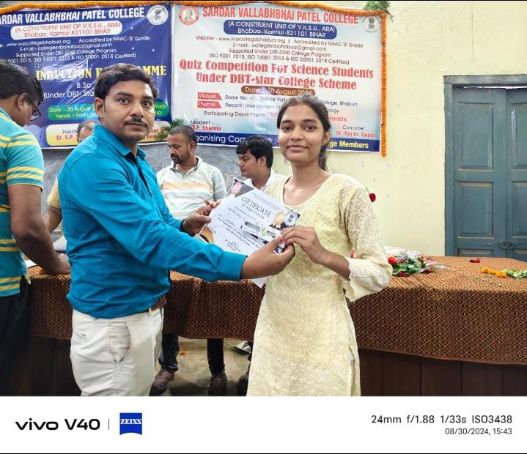
Outreaching Activities

Slide 22
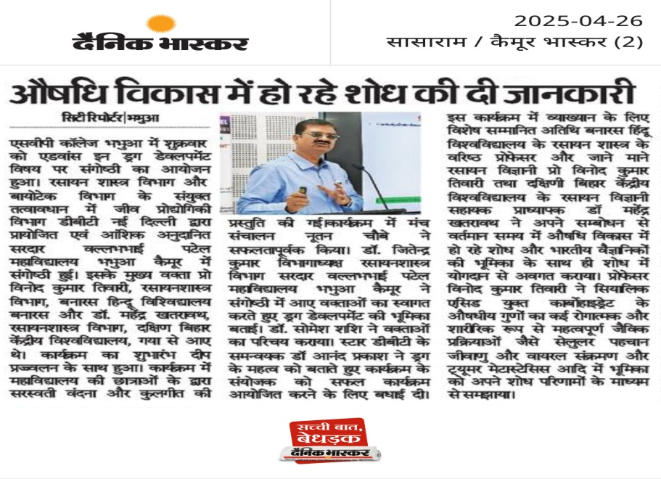
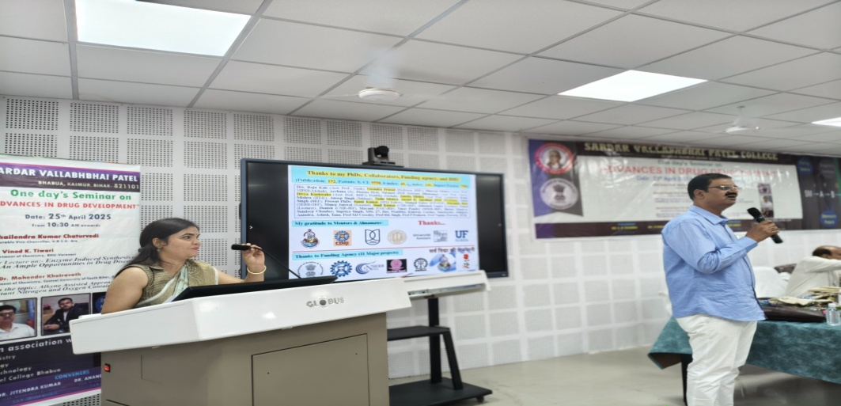
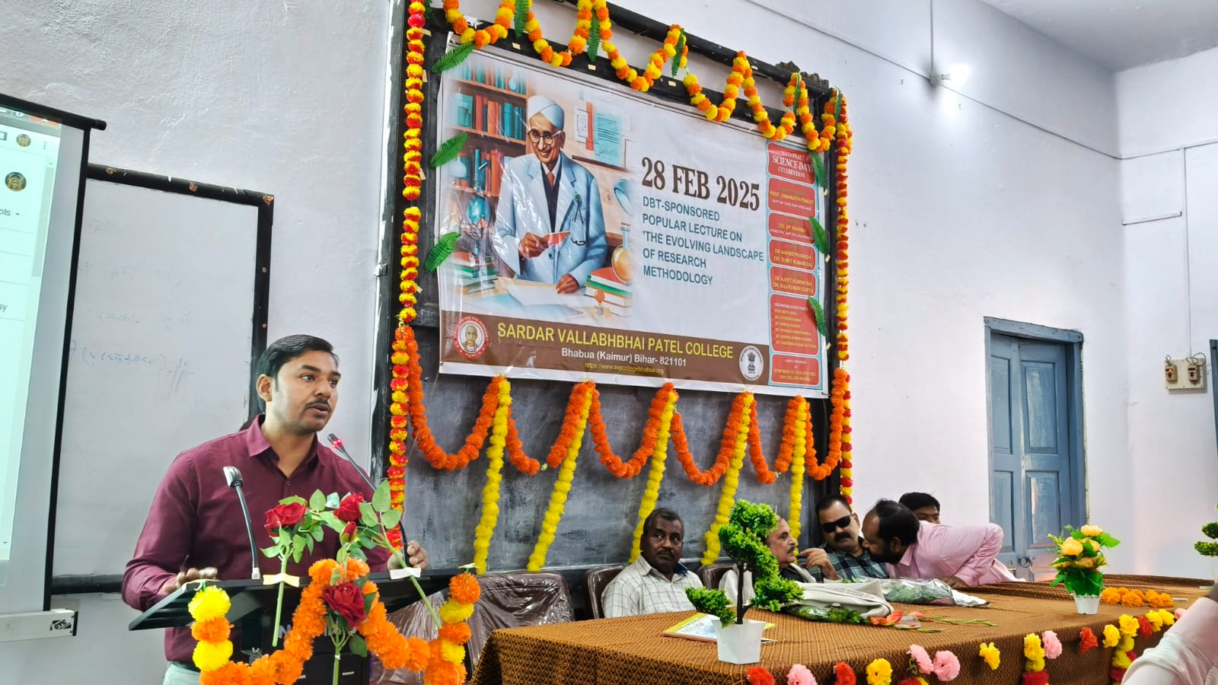
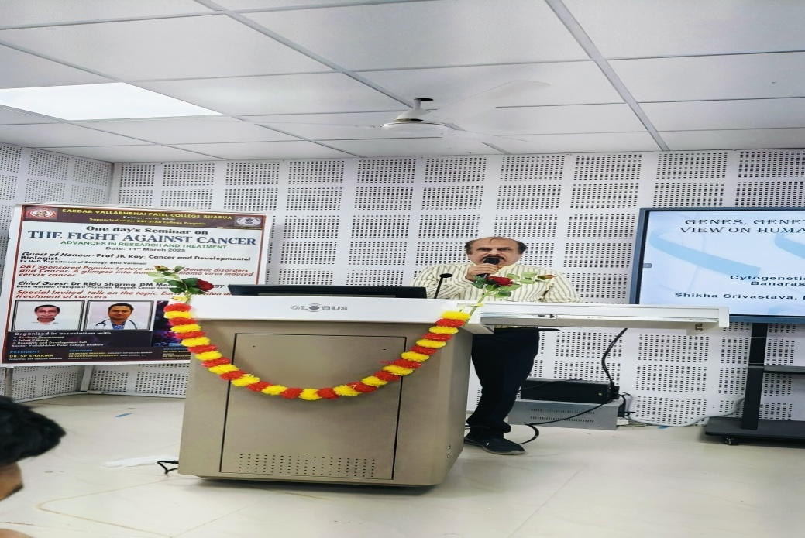
Lectures and Seminars

Slide 23
SWOC Analysis
STRENGTH
Well-Qualified Faculty
WEAKNESS
Limited Funding Support (Self-Financed Nature)
OPPORTUINITY
Scope for Interdisciplinary Collaboration
CHALLANGES
Recognition as a STAR College under DBT
Student-Centric Approach
State-of-the-Art Laboratories
Extra-Curricular Engagement
Lack of PG and Research Programs
Limited Placement Opportunities
Language Barrier and Soft Skills
Infrastructural Constraints
Limited Alumni Engagement
Dependence on External Funding
Skill Development & Add-On Courses
Alumni Engagement
UGC/DBT/ICMR Project Funding
Expanding Industry Tie-ups
Retention of Faculty
Limited Awareness Among Stakeholders
Brain Drain to Metro Cities
Competition from Private Institutions
Rapid Technological Advancements

Slide 24
Future plans
Academic Expansion
Curriculum revision
Introduction of certification programs
Infrastructure Development
Up gradation of existing laboratories with advance equipments
Industrial collaboration
Partner with industry and research organization for internships , placements and research opportunities
Social outreach
Biotechnology awareness program for school students and farmers
Introduction of PG program

Slide 25
THANK YOU
“Empowering Innovation, Enriching lives through Biotechnology.”

